Slide 1
AE Cloud2 Arduino Firmeware with SHT31 (Use Arduino Header)
By Michael Li 4/1/2019

Slide 2
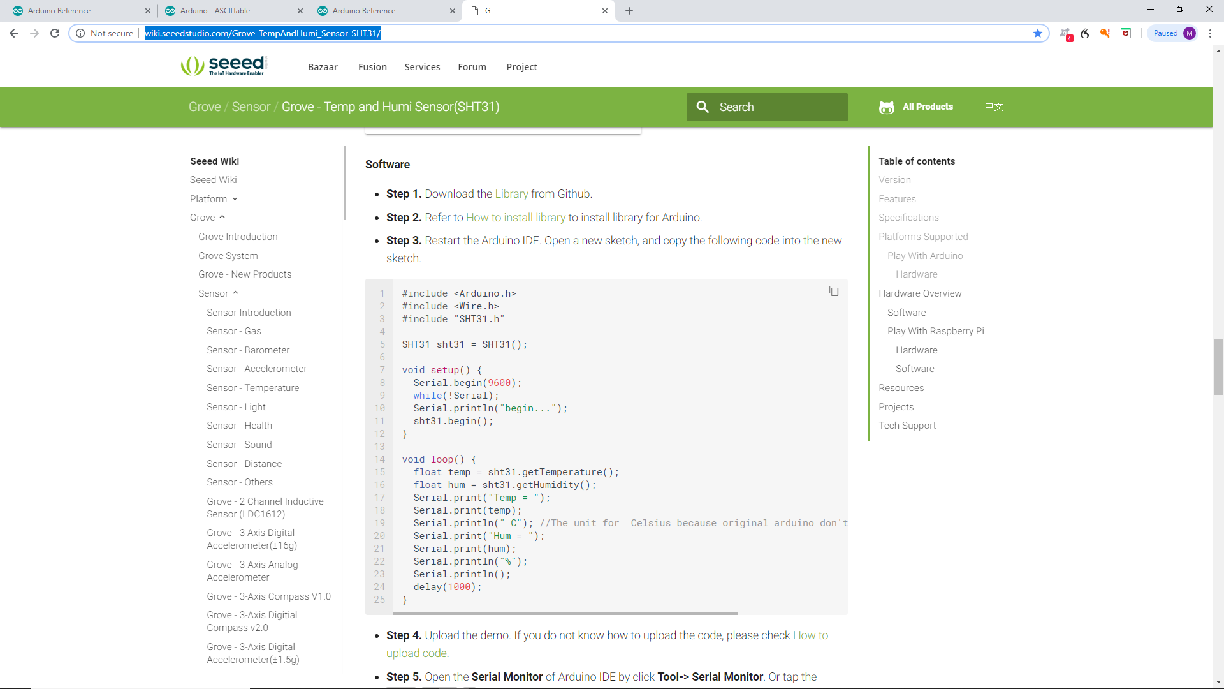
http://wiki.seeedstudio.com/Grove-TempAndHumi_Sensor-SHT31/
Copy the new sketch ino file and SHT31.h/cpp files.

Slide 3
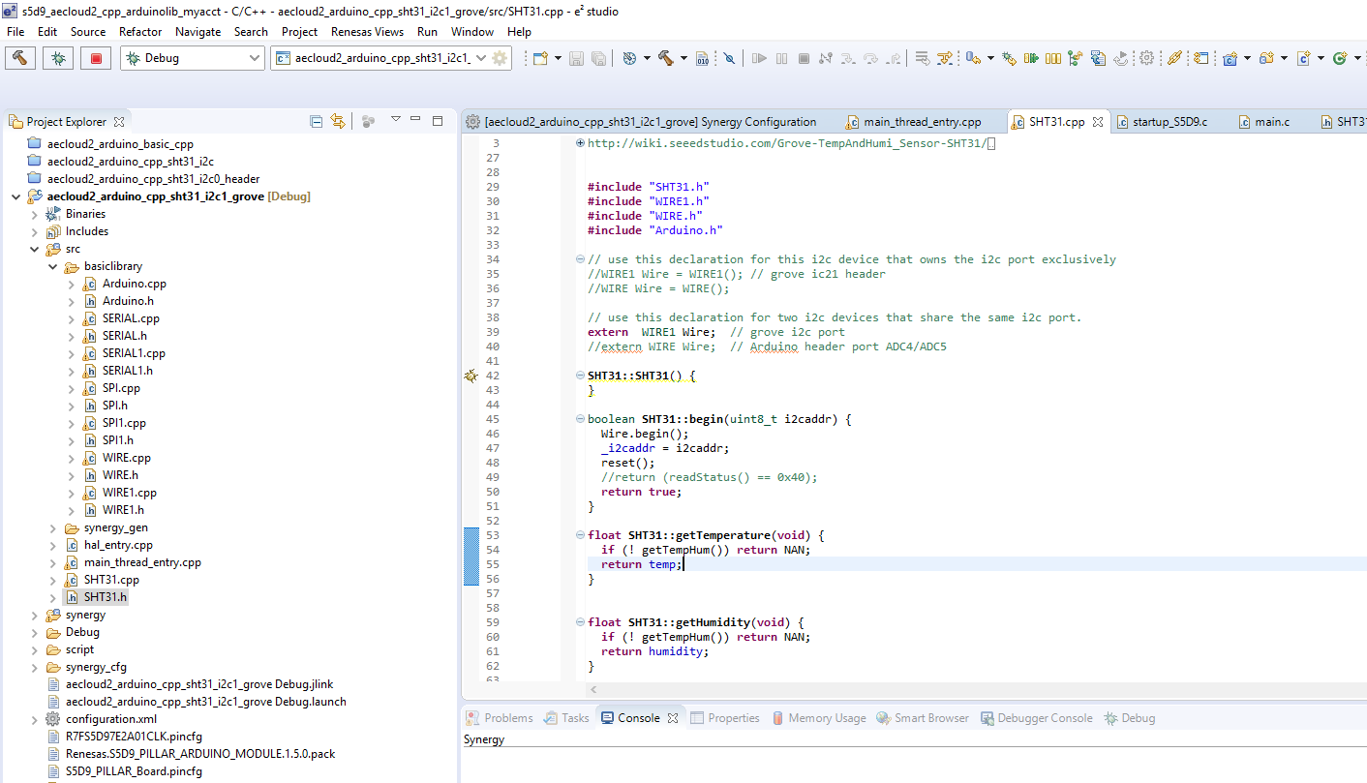
Copy SHT31.h/cpp to SRC folder and add some headers/class objects.

Slide 4
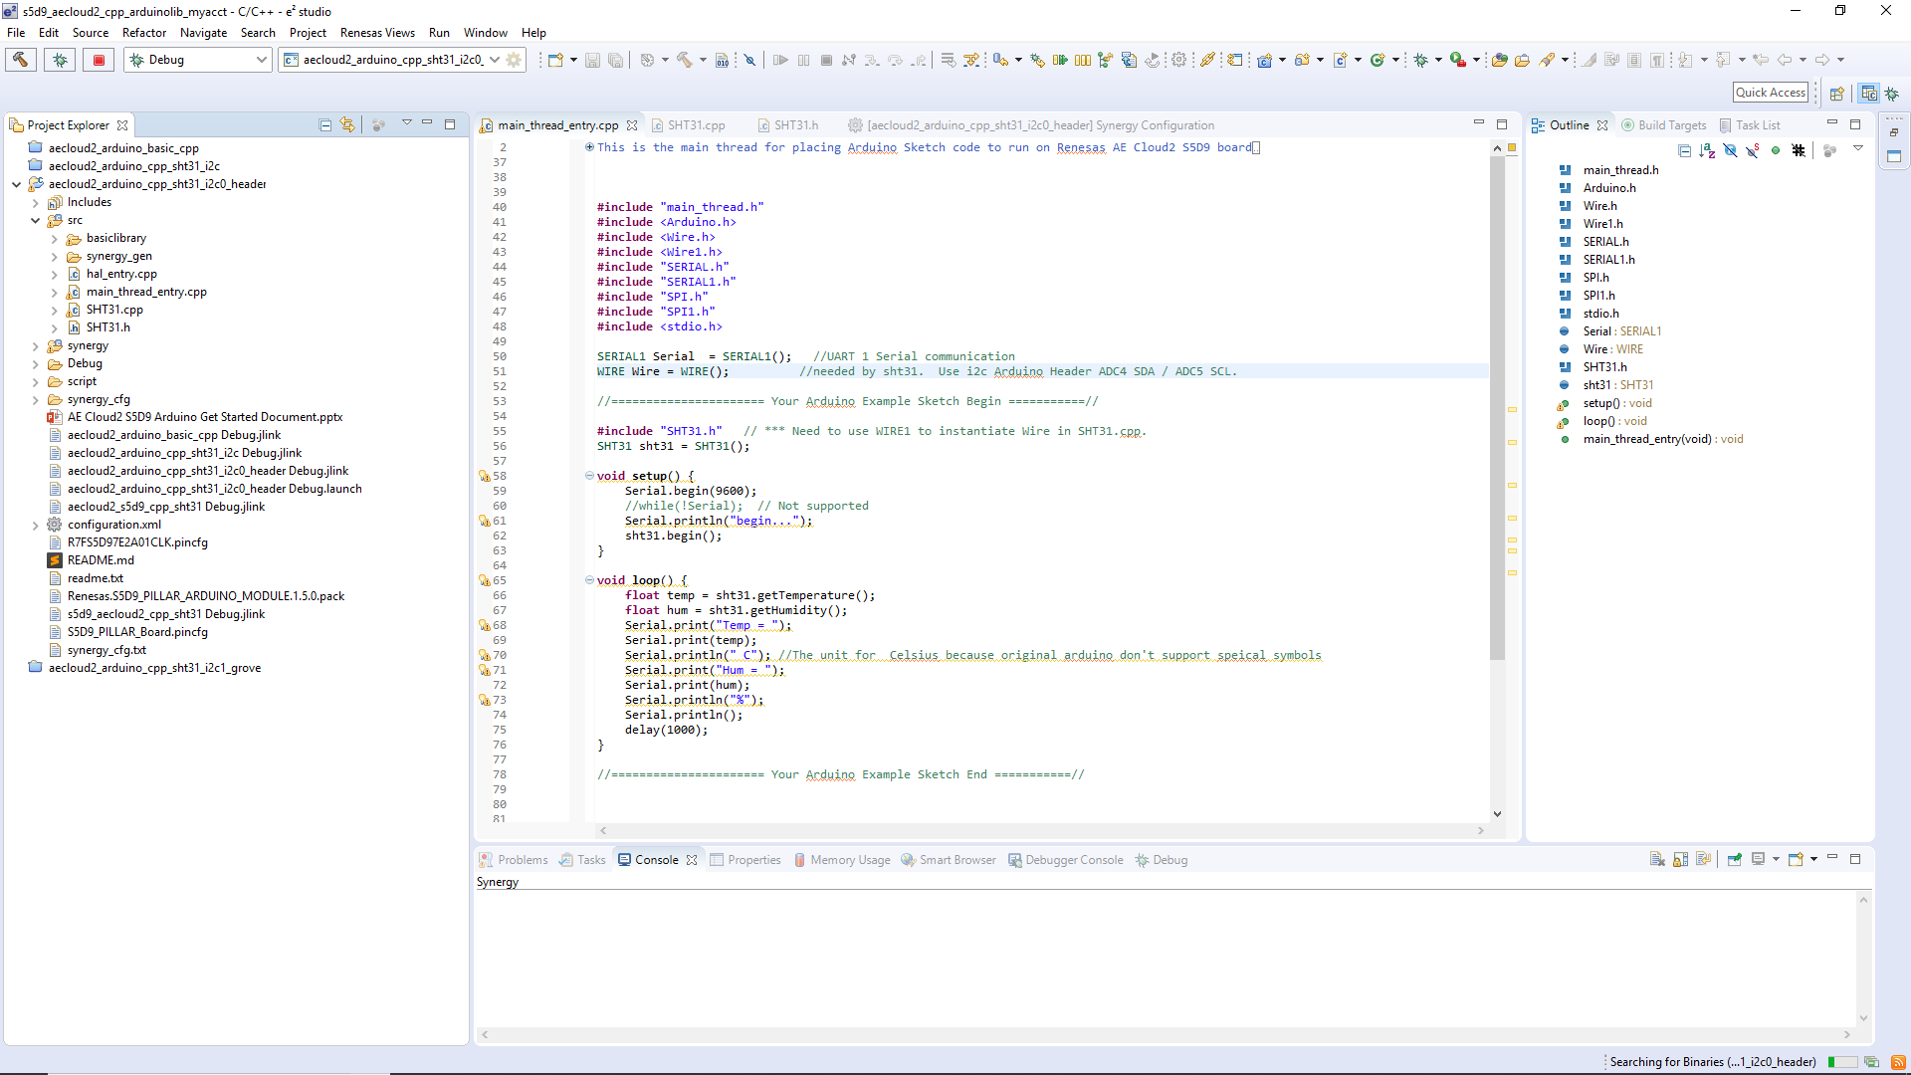
Main Thread : the example INO code.

Slide 5
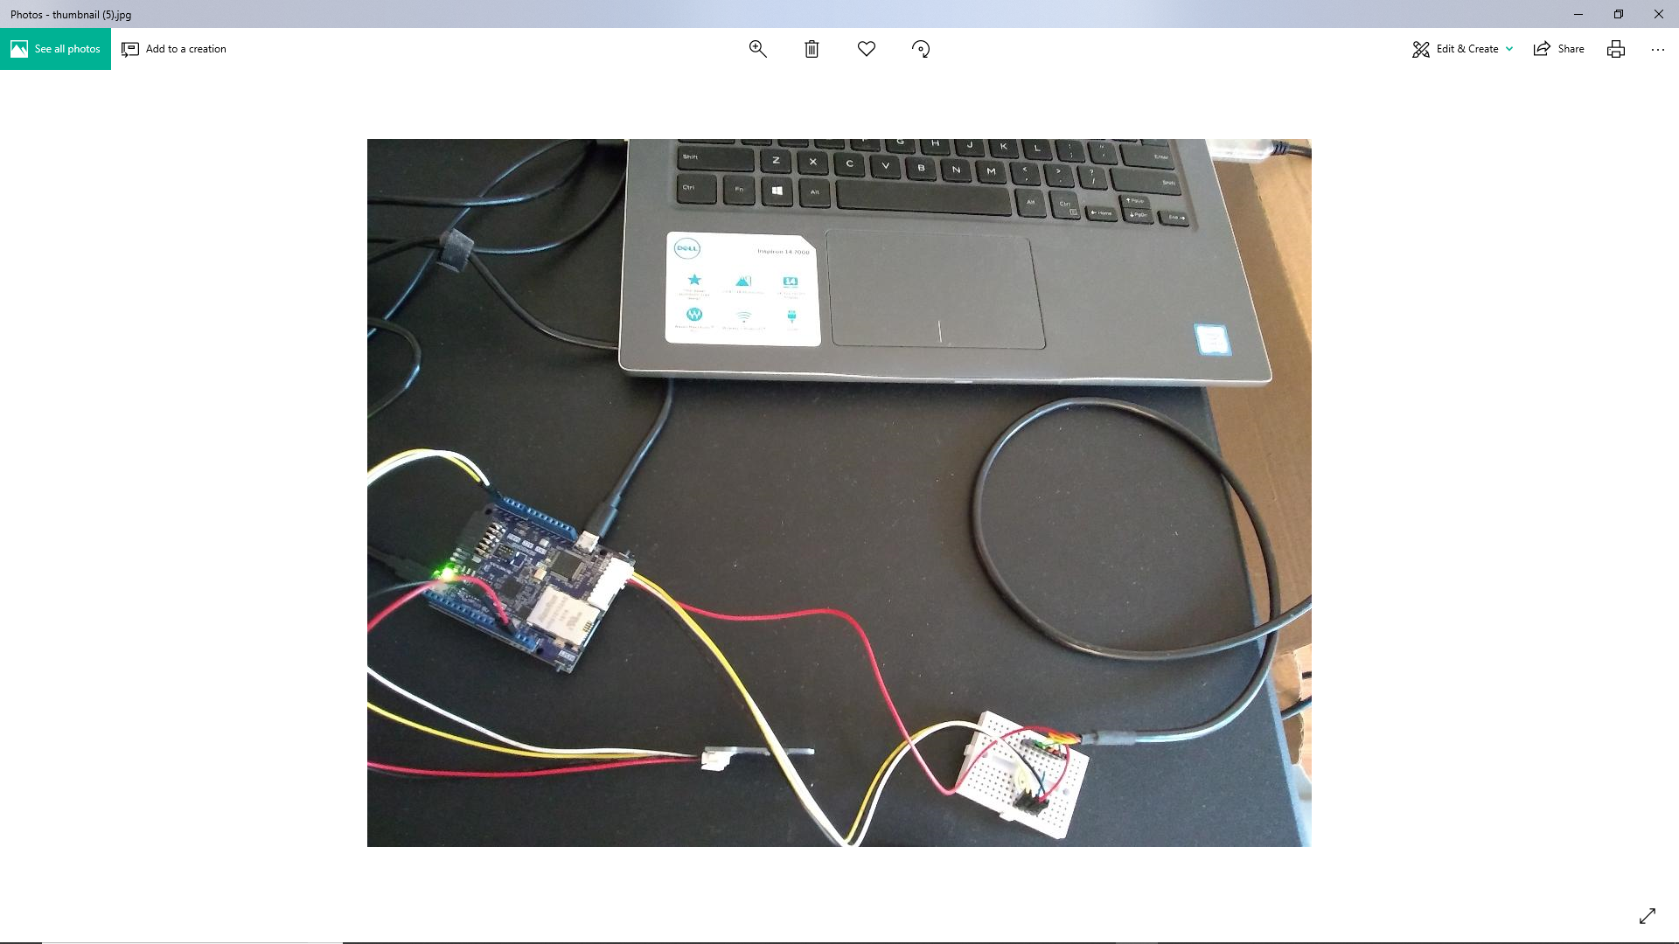
Hardware Setup A5 (SCL yellow), A4 (SDA white) GND (Black), Red (VREF= 3.3V)

Slide 6
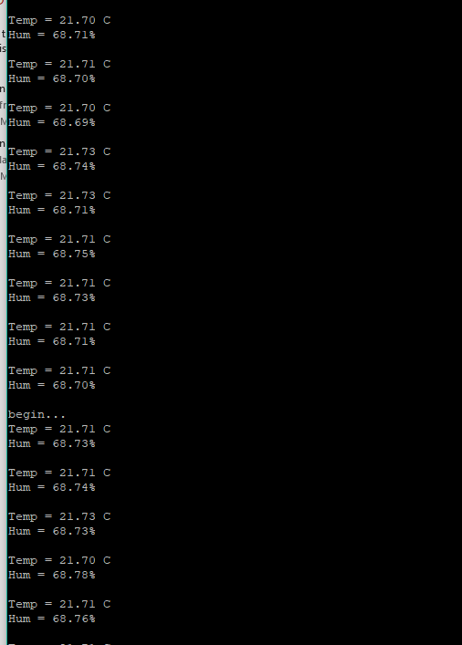
Terminal (Serial) Putty.

